Slide 1
Group Sow Housing

Slide 2
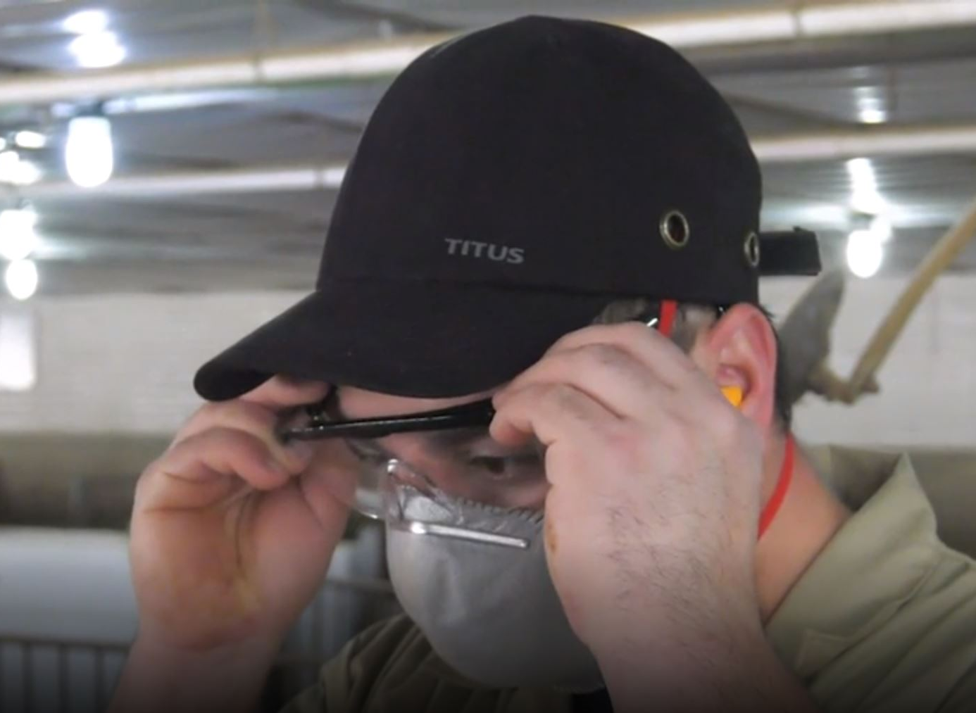
Group Sow Housing
Step 1
Put on your personal protective equipment (PPE).
Recommended PPE:
  Steel toe boots
  Earplugs
Suggested PPE:
  Bump caps
  Dust masks
  Knee pads
  Safety glasses

Slide 3
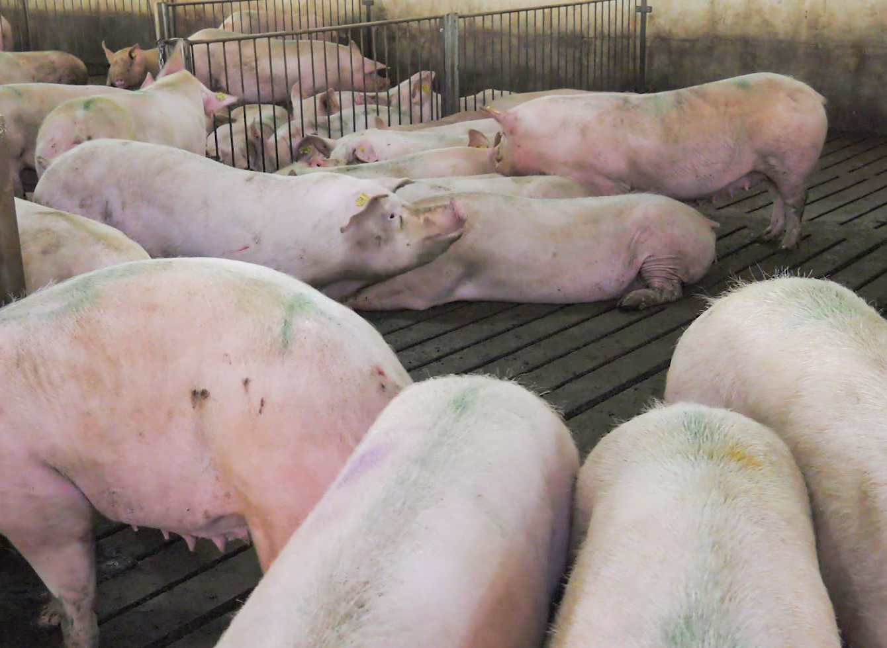
Group Sow Housing
Step 2
Recognize normal sow behavior.
Eating
Drinking
Sleeping
Occasional fighting, especially after weaning
  Always carry a sort board to separate aggressive sows.
  If you cannot safely separate the sows, back away and let them fight it out.

Slide 4
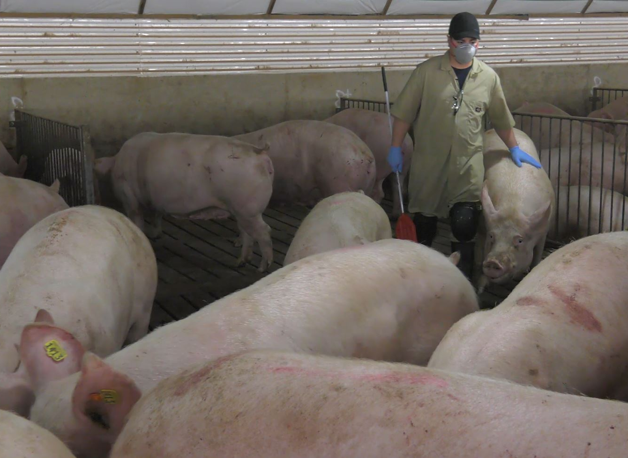
Group Sow Housing
Step 3
Calmly and quietly interact with sows regularly.
Walk calmly through the sows to observe or chore.
Respect the flight zones of individual sows as well as the flight zone of the herd.
Use minimal noise and only when necessary.
Communicate your presence with gentle touch.
Bend the knees to squat, don’t bend at the waist.

Slide 5
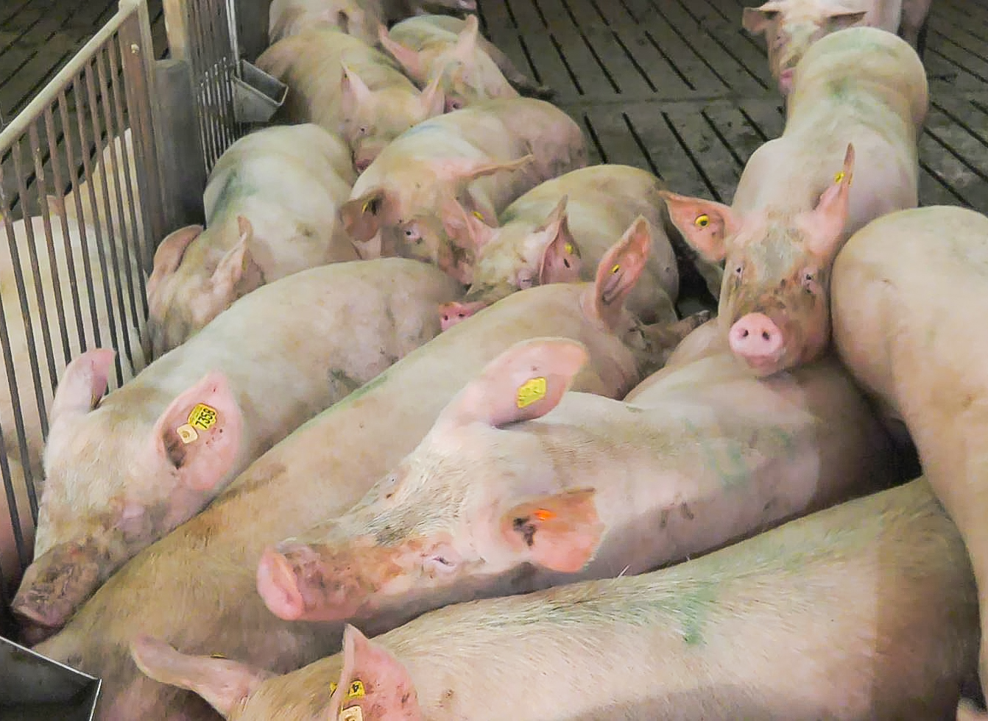
Group Sow Housing
Step 4
Observe freshly weaned sows regularly and monitor for fighting.
Use a sort board.
Have an escape route.
If sows are fighting, it might be possible to separate them if aggressive intention has just started.
  If necessary, let them fight it out to stay safe.

Slide 6
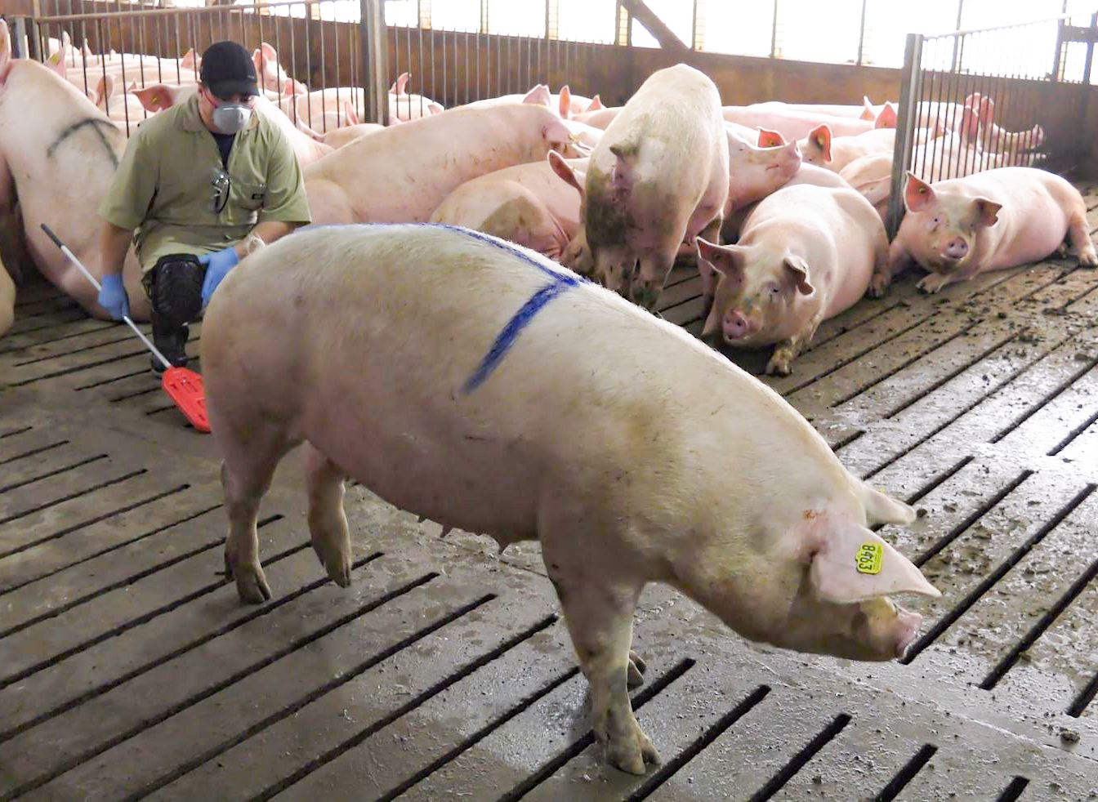
Group Sow Housing
Step 5
Identify and treat sick sows.
Do a head to tail observation of every sow and look for clinical signs that are abnormal.
  Lethargic
  Feverish
  Thin
  Lame
  Off-feed
  Other
Avoid slip and trip hazards.
  Bodily fluids
  Feces
  Damaged flooring
Handle needles safely between use.
  Never carry uncapped needles in your pocket.
  Always use pliers to recap needles.
  Always dispose of used, bent, burred, or dirty needles in designated sharps containers.

Slide 7
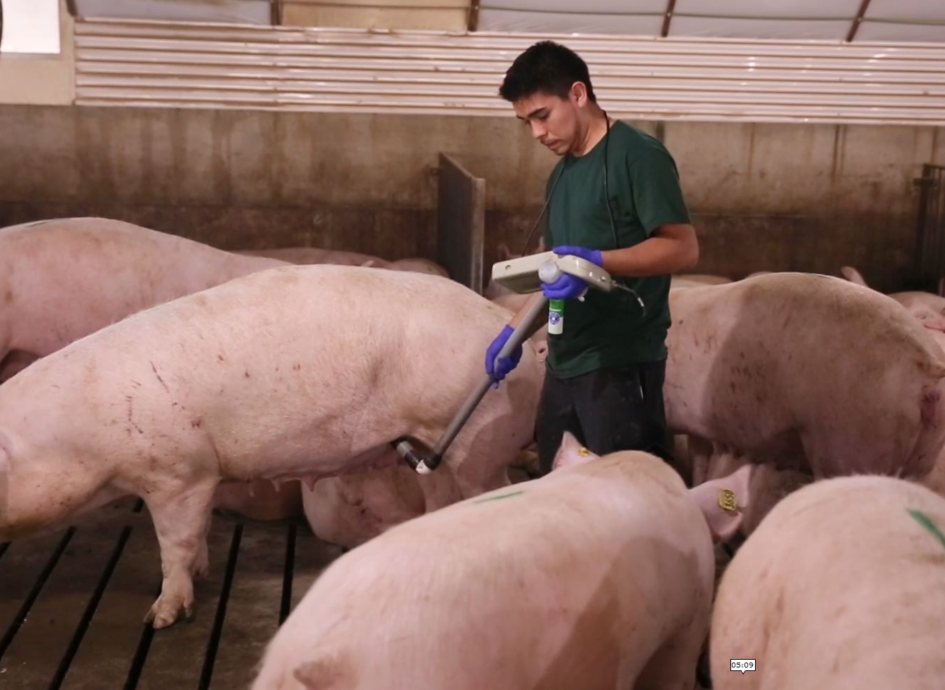
Group Sow Housing
Step 6
Follow your farm’s protocol for the timing of pregnancy confirmation.
Ultrasound according to your farm’s protocol.
Conduct weekly walk-throughs to visually confirm pregnancy in sows 60+ days pregnant.
Do not perform ultrasounds if a boar is in the pen and you are alone.
Remain aware of the behavior of other females in the pen.

Slide 8
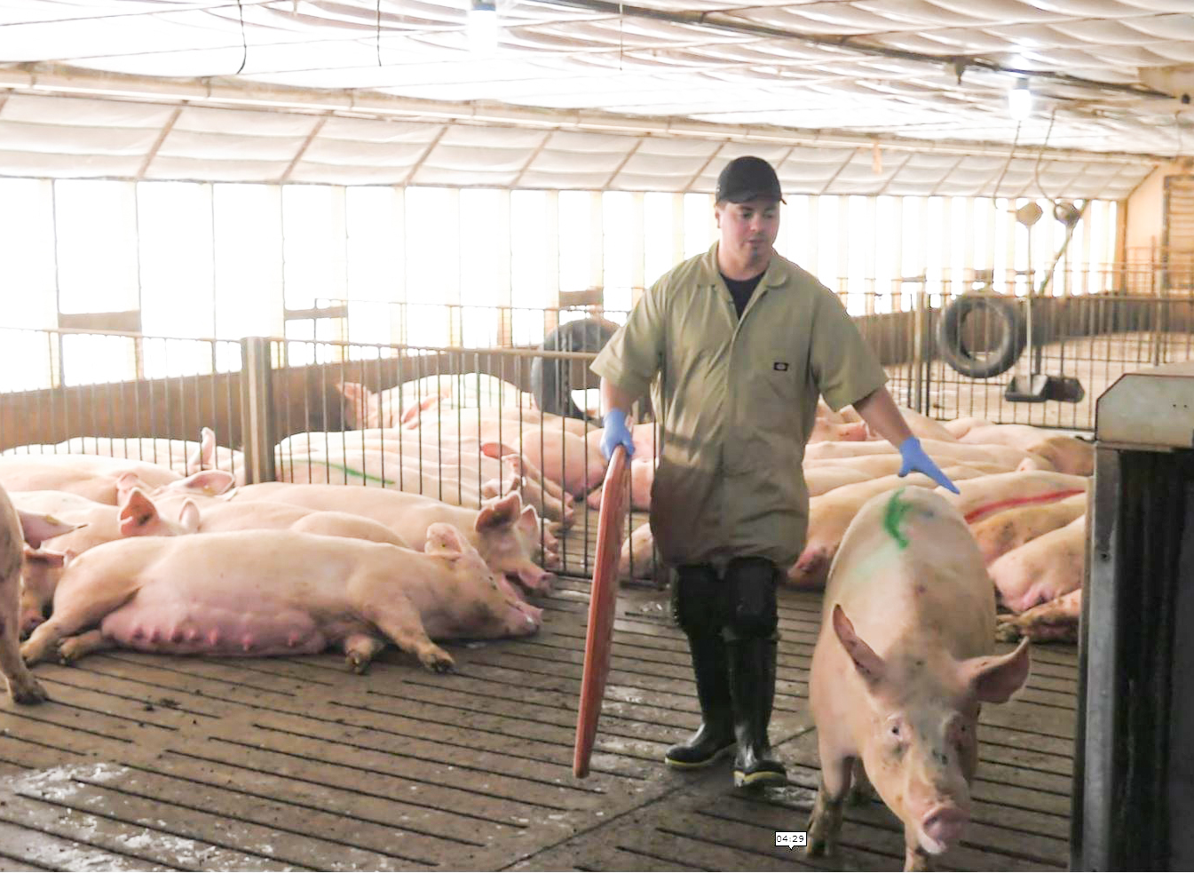
Group Sow Housing
Step 7
Sort sows out when needed for special treatment or movement.
Prepare the path of movement before sorting.
Enter the pen with a coworker, each with a sort board.
Keep a slight bend to the knees while in the pen.
Use the sort board to separate the sow and encourage forward movement to her destination.

Slide 9
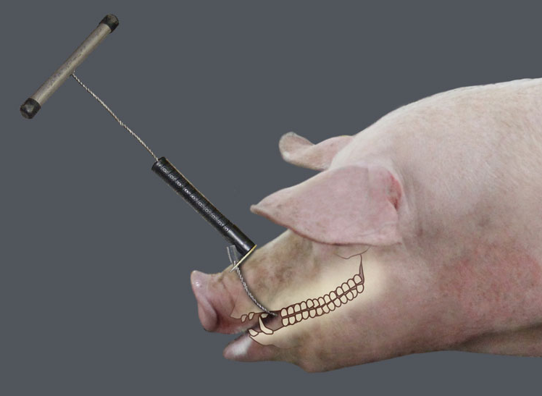
Group Sow Housing
Step 8
Tag gilts prior to entry to a group according to your farm’s protocol.
The center of the ear is the correct placement for the tag.
  Improper placement increases the risk of the tag being pulled out,
If using a snare
  Snare behind the canines.
  Release the snare careful to prevent injury.

