Slide 1
Heat Checking & Breeding

Slide 2
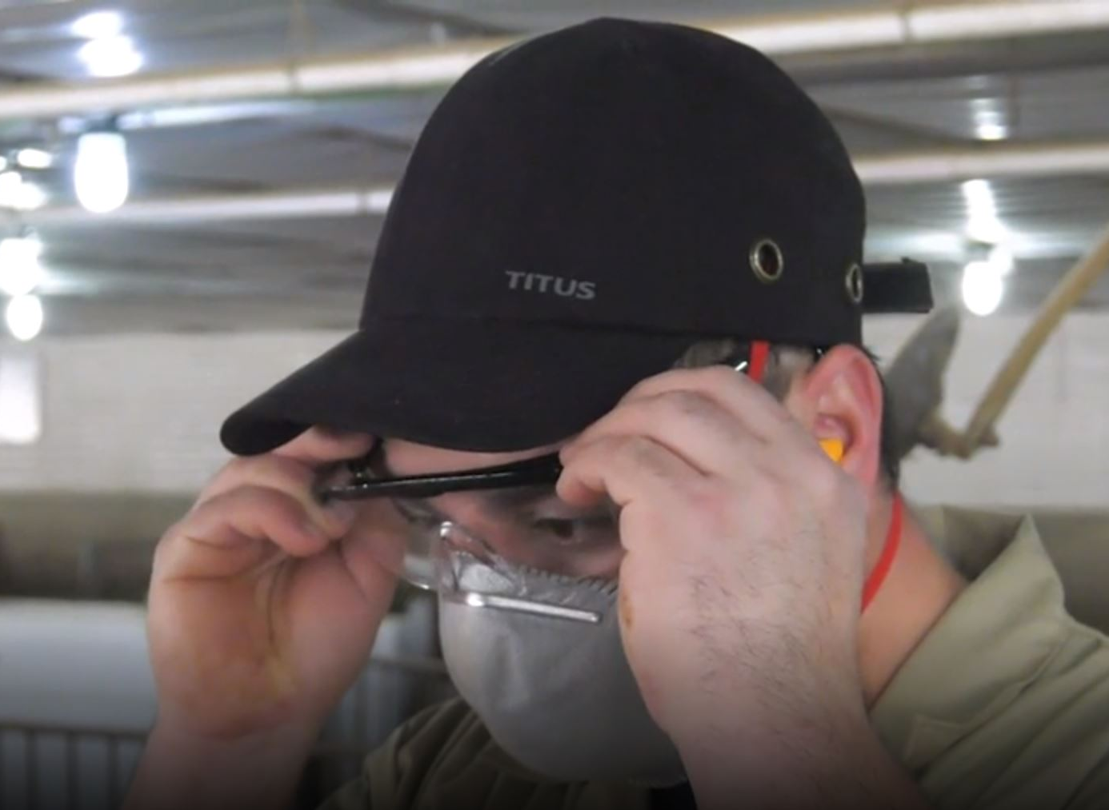
Heat Checking & Breeding
Step 1
Put on your personal protective equipment (PPE).
Recommended PPE:
  Steel toe boots
  Earplugs
Suggested PPE:
  Bump caps
  Dust masks
  Knee pads
  Safety glasses

Slide 3
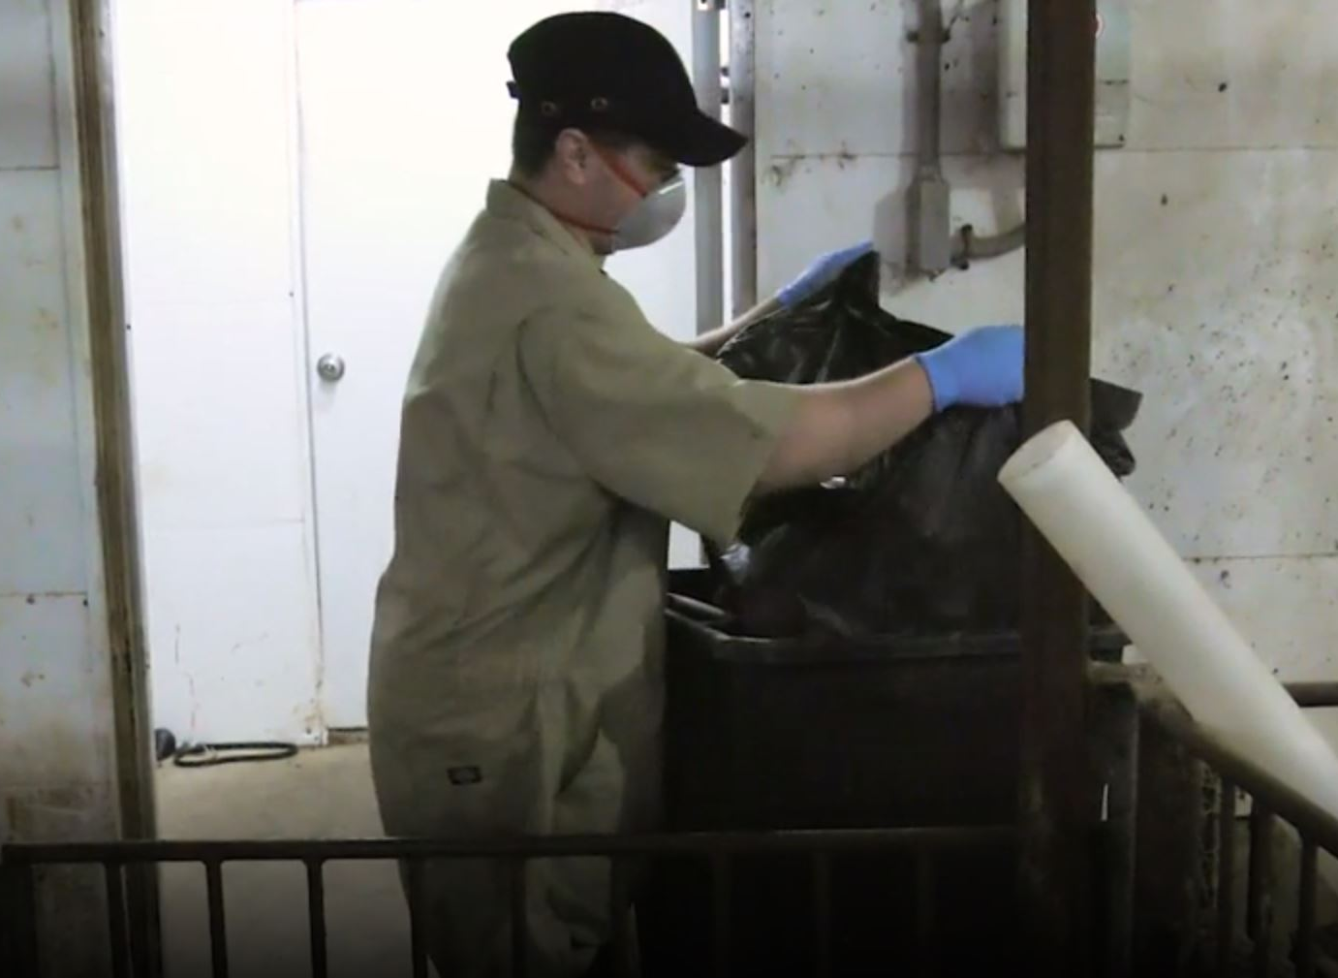
Heat Checking & Breeding
Step 2
Conduct routine preparation and maintenance.
Dispose of all trash immediately after use to eliminate trip hazards.
Repair or replace bent gate and stall rods.
Clean, dry, and disinfect the breeding row between breed groups to prevent disease spread and eliminate slipping hazards.

Slide 4
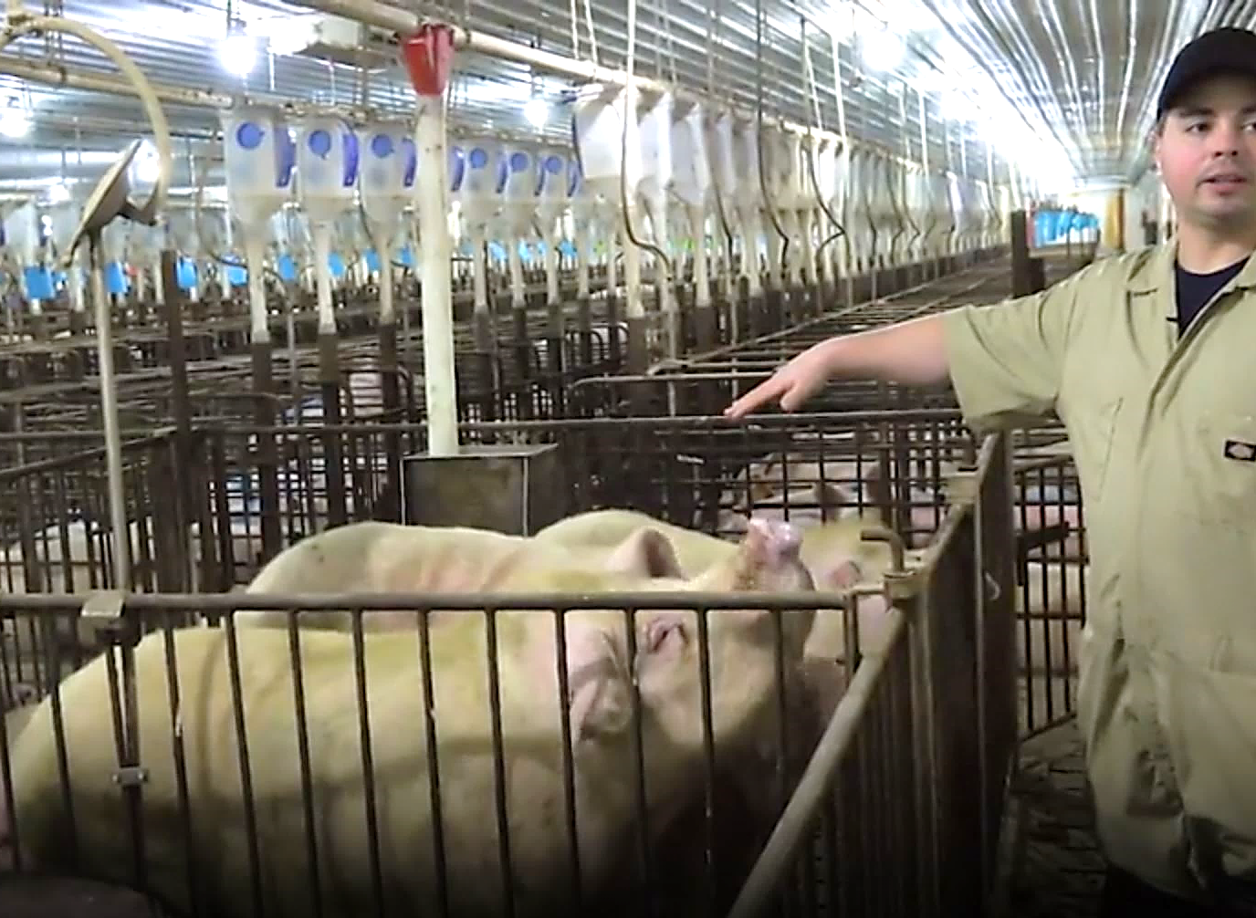
Heat Checking & Breeding
Step 3
Choose the right boar for heat\h checking in pens.
Boars should be approximately the same size or only slightly larger than gilts or sows.
  Large boars can injure gilts under their weight.
Boars should not be too old.
  Older boars can be more aggressive, or unpredictable, and have long tusks.

Slide 5
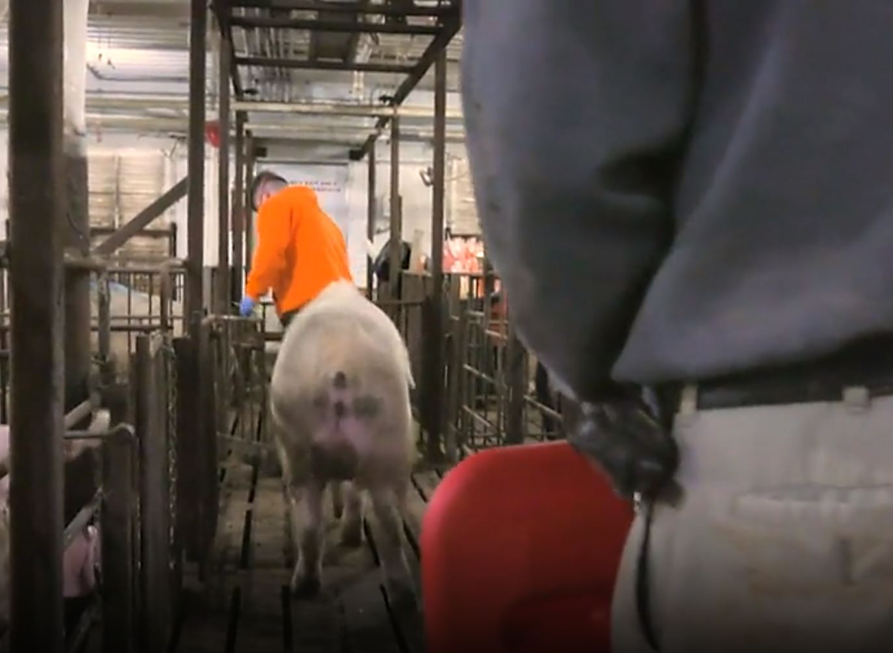
Heat Checking & Breeding
Step 4
Hook up and lead the boar safely.
Manual lead
  Carry a sorting board.
  Never wrap the rope around your wrist.

Slide 6
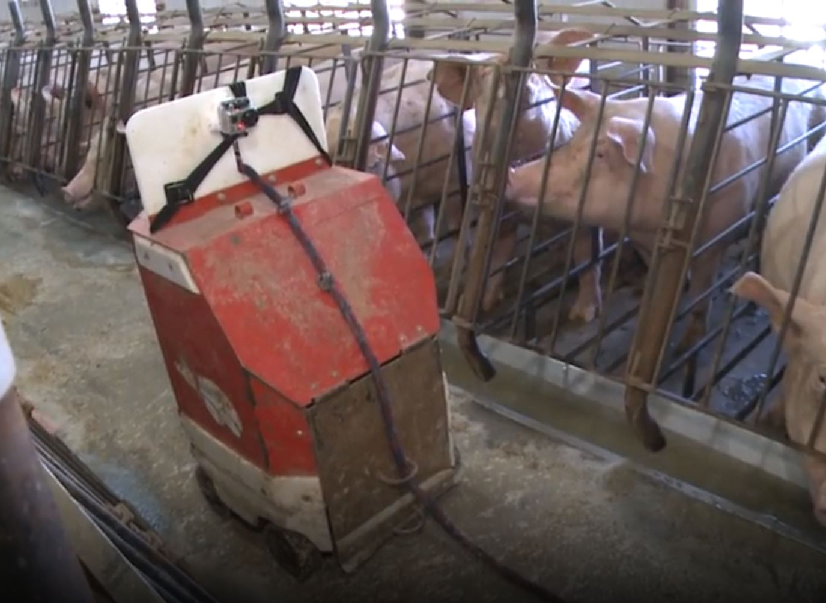
Heat Checking & Breeding
Step 4
Hook up and lead the boar safely.
Boar bot
  Use a well-fitted boar harness.
    Check the boar regularly for signs of irritation under the harness.
    Loosen harness as boar grows.
  Tie the boar to the bottom rung to prevent tipping.
  Stand behind the stall gate for protection while attaching the boar to the bot.
  While standing behind the boar and boar bot, use the remote control to move the boar bot.

Slide 7
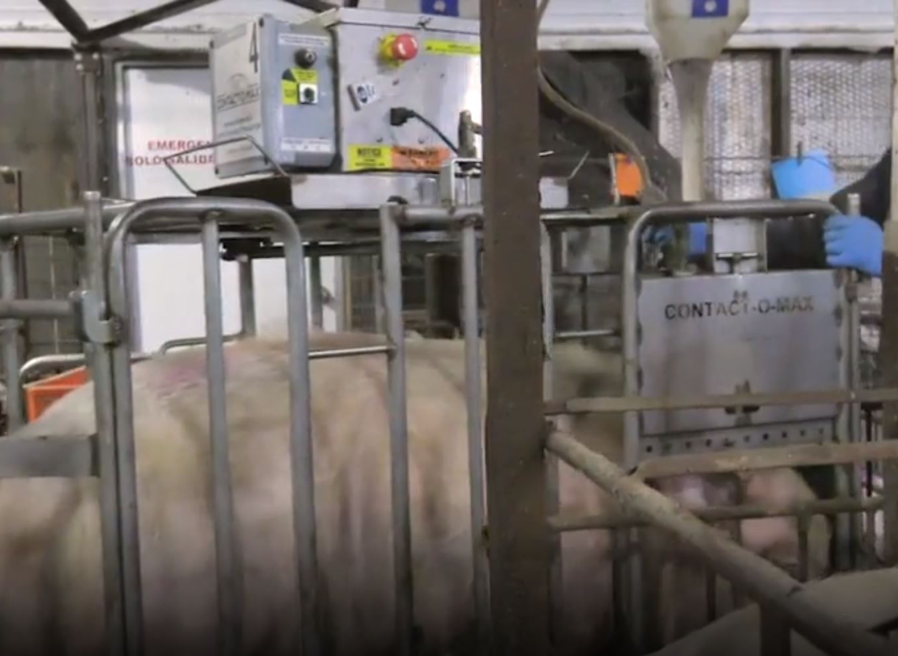
Heat Checking & Breeding
Step 4
Hook up and lead the boar safely.
Boar cart
  Use two people to load the boar.
  Carry a sort board when loading or unloading the boar.
  Bring the cart to the stall.
  Block all escape routes, open the stall, and lead the boar directly into the cart.

Slide 8
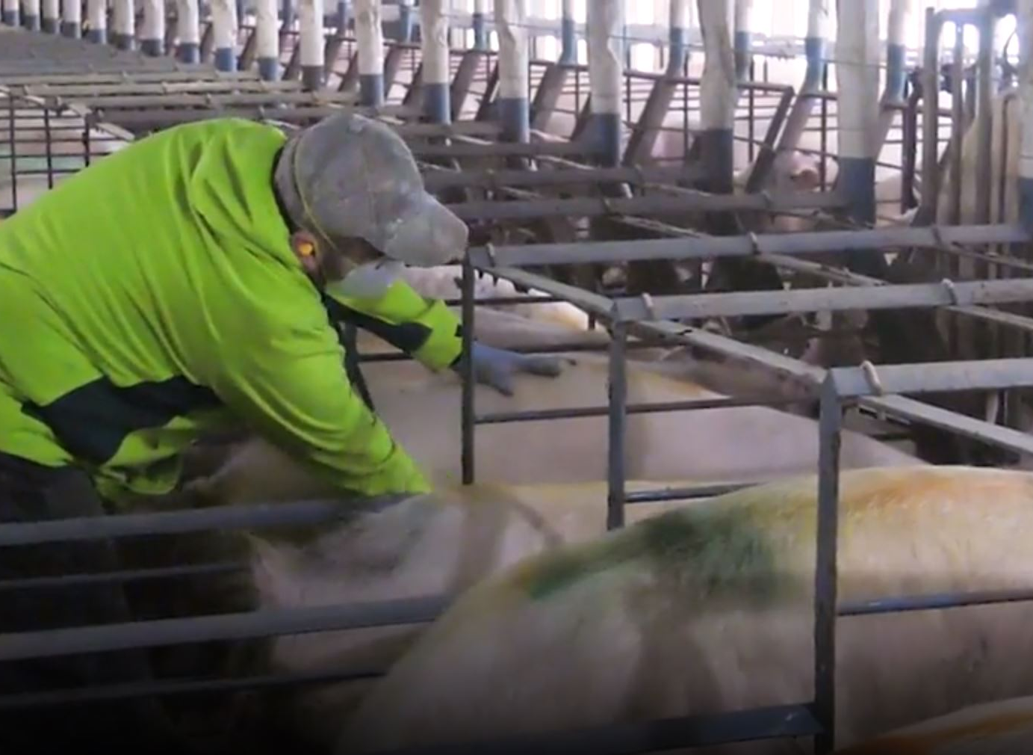
Heat Checking & Breeding
Step 5
Heat check.
Communicate your presence with gentle touch to avoid startling the females.
Encourage all sows to rise and interact with the boar.
Watch for pinch and trap points between the female and the stall.
Minor Corrections Underway
Visually assess for signs of heat.
  Ears standing straight
  Swollen vulva with mucous
Physically assess for signs of heat.
  Apply pressure to her back
  Nudge her flank
  Rub her underline
Mark and record all females in heat.
When working in pens
  Always carry a sort board.
  Work in pairs when a boar will be giving shoulder to shoulder contact in the pens.
  Keep your knees slightly bent.

Slide 9
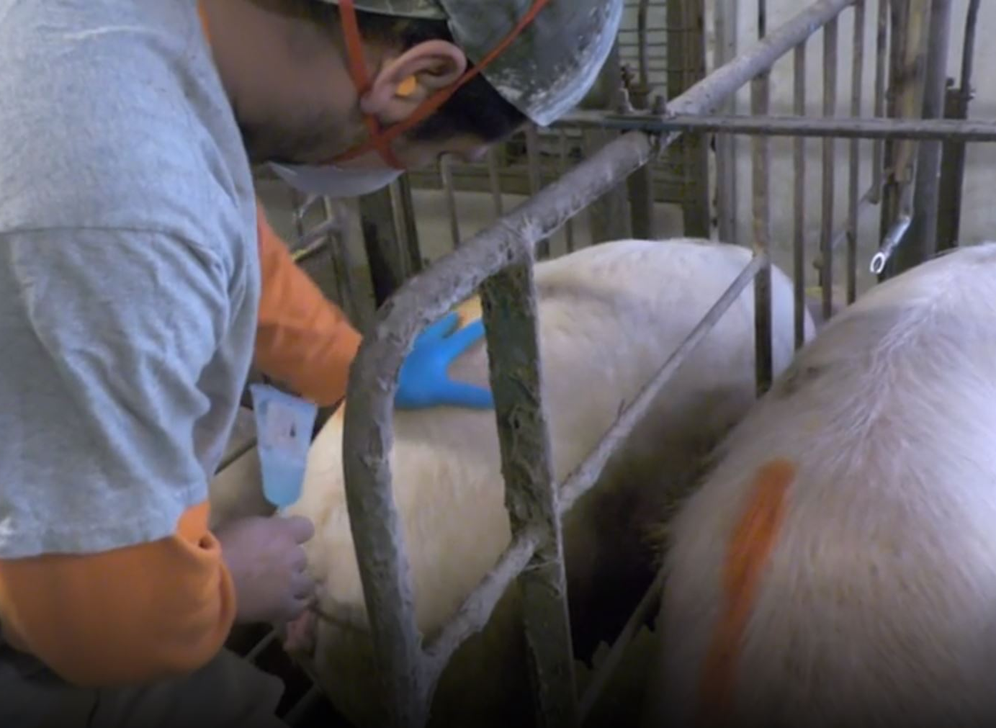
Heat Checking & Breeding
Step 6
Breed sows and gilts found in heat.
Watch for pinch points.
Avoid sticking your arms and hands between the body of the female and the bars of the stall.

