Slide 1
Vaccinating & Treating

Slide 2
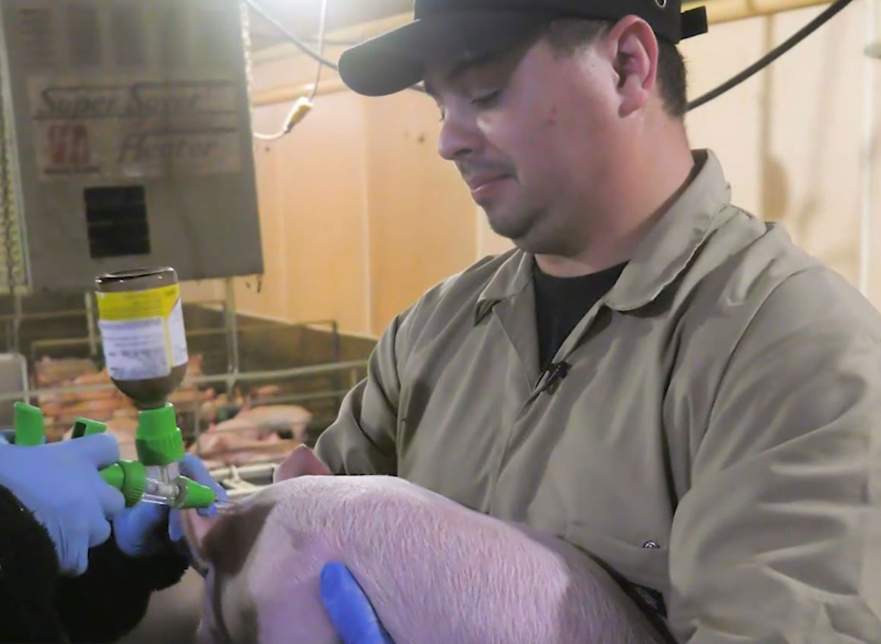
Vaccinating & Treating
Step 1
Slow down and properly restrain animals to reduce risk of puncture injuries or lacerations to handlers and pigs.

Slide 3
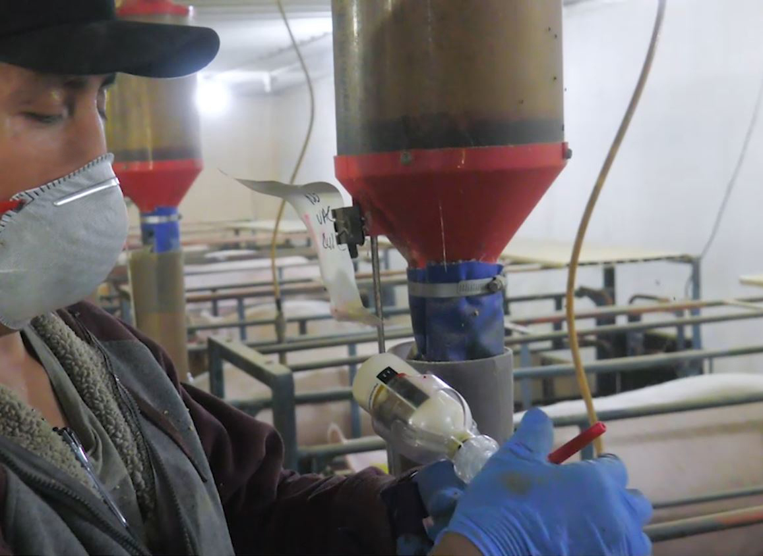
Vaccinating & Treating
Step 2
Make safety a priority when working with needles.
Leave the cap on the needle until you are ready to inject the first pig.
Attach a needle guard to the syringe whenever possible.
Choose the correct size needle for the pig you are injecting.
  Piglets, nursery pigs, market or finishing hogs, and breeding stock will all need different sizes of needles. Refer to your farm protocol or to the materials available at www.pork.org for additional information related to proper needle size.

Slide 4
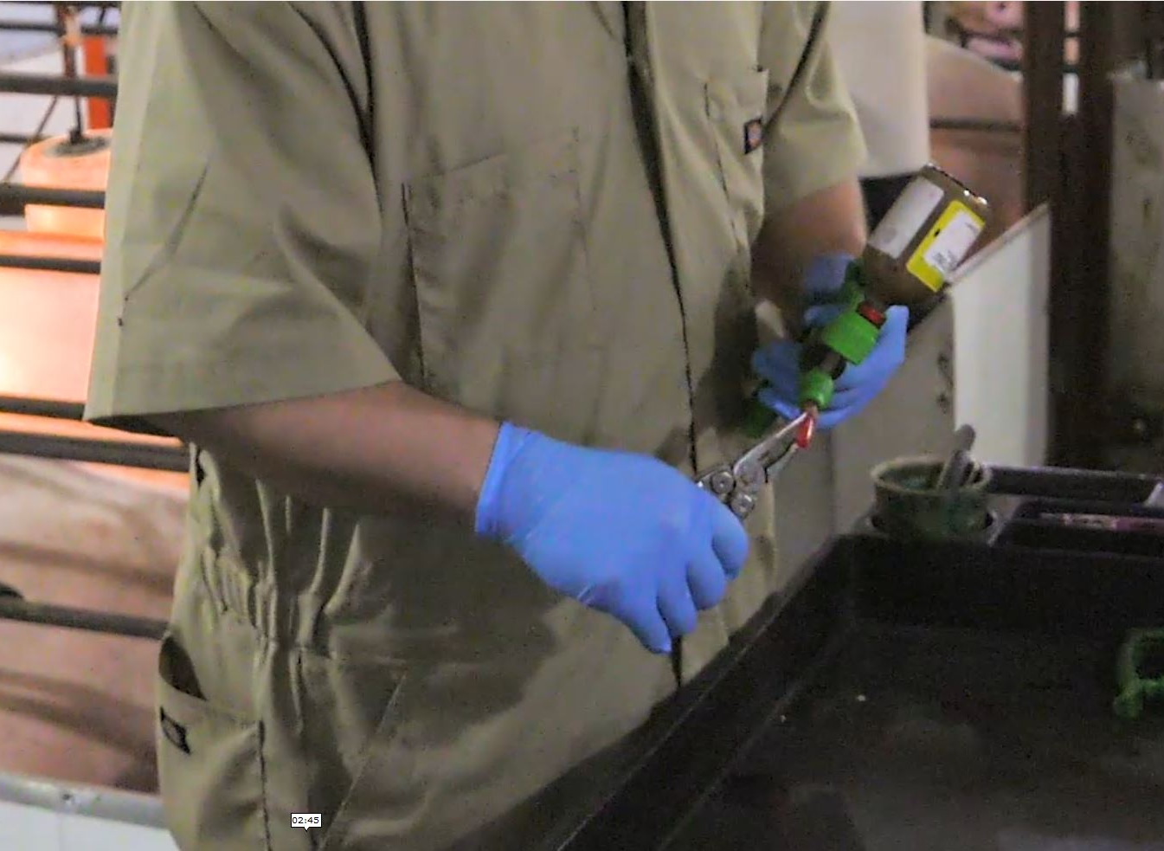
Vaccinating & Treating
Step 3
Follow safety guidelines to keep yourself safe from accidental injections.
ALWAYS
  Carry the syringe in your hand with the needle pointing towards the ground.
  Use pliers to recap needles.
  Discard used, bent, burred, or dirty needles.
  Dispose of needles in an approved and properly labeled sharps container.
  Report needle stick injuries to management and contact your health care provider if you have a needle stick injury.
  Follow your veterinarian’s instructions depending on the health at your farm and know your farm’s protocol for changing needles.
NEVER
  Put uncapped needles or syringes in your pockets.
  Reuse needles or attempt to straighten them.
  Attempt to remove needles from sharps containers.

Slide 5
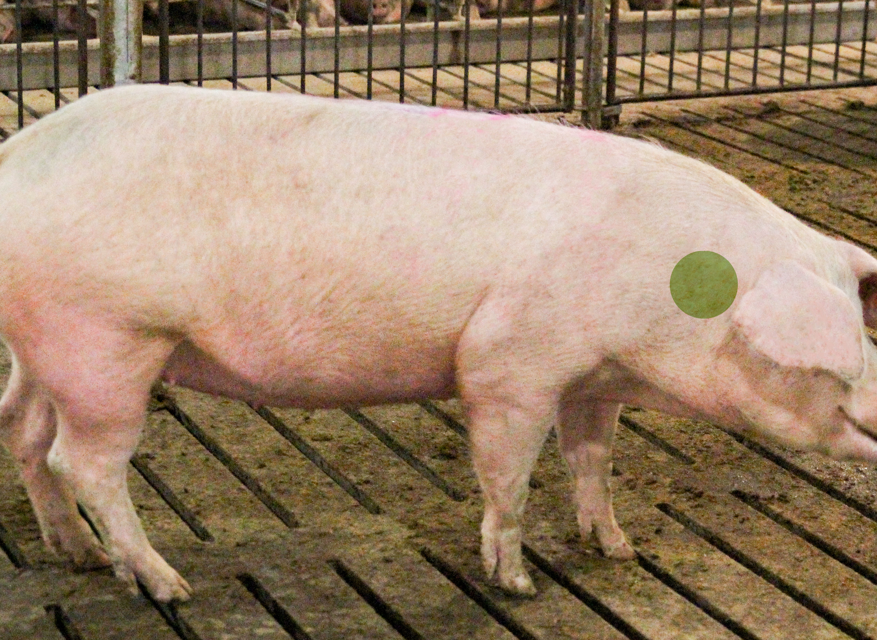
Vaccinating & Treating
Step 4
Administer injections in the correct location.
Inject in the neck muscle, behind the ear.
Do not inject in the ham or loin unless directed by your veterinarian.
Mark and record the pigs that have been treated or vaccinated to prevent over- or under-medicating, missing treatments or transporting to market before withdrawal time has been completed.
Improper administration of vaccinations or treatments endangers the health of the pig.

Slide 6
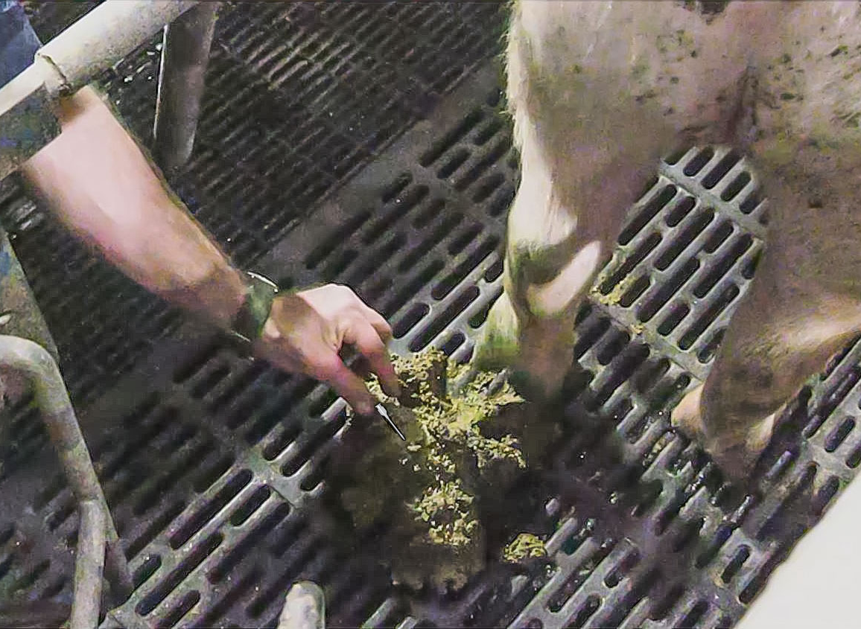
Vaccinating & Treating
Change needles frequently according to your farm’s protocol.
Step 5
Always retrieve any dropped needles.
  Lost needles are sometimes found in the mouth, throat, or feet of pigs.
Count the number of needles you take into the barn and count the number of needles you take out of the barn. The number should always match.
  Do not leave used needles in the barn.

Slide 7
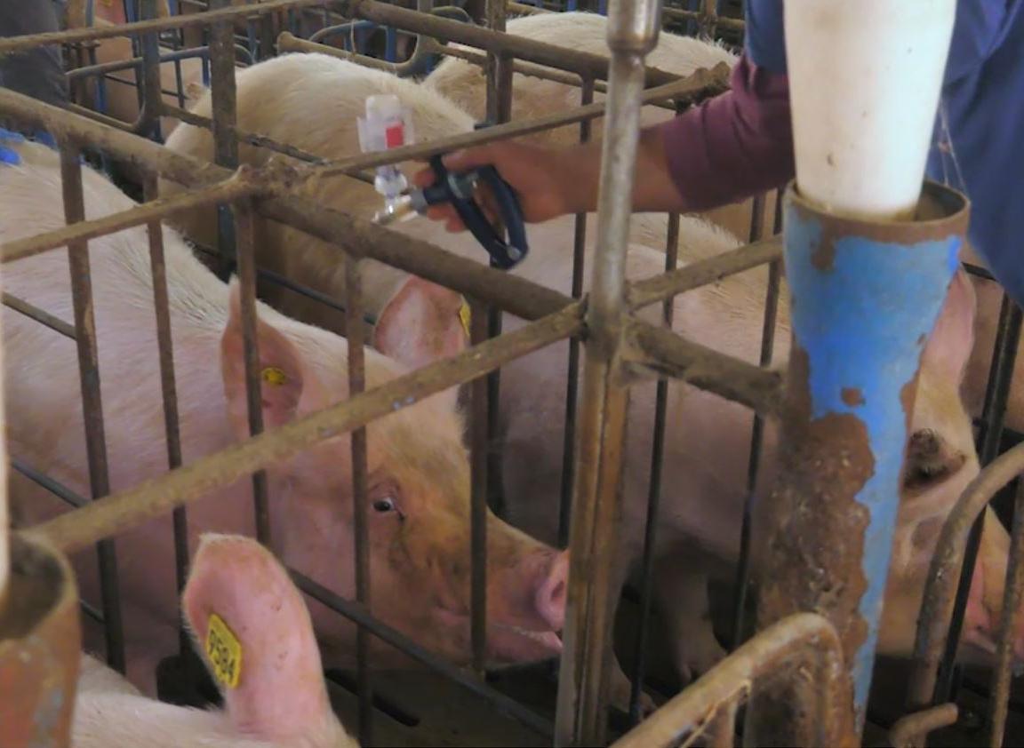
Vaccinating & Treating
When injecting sows in stalls, the stall itself is the only restraint you need.
Step 6
Be aware of the stall bars.
Inject the sow and remove the syringe quickly.

Slide 8
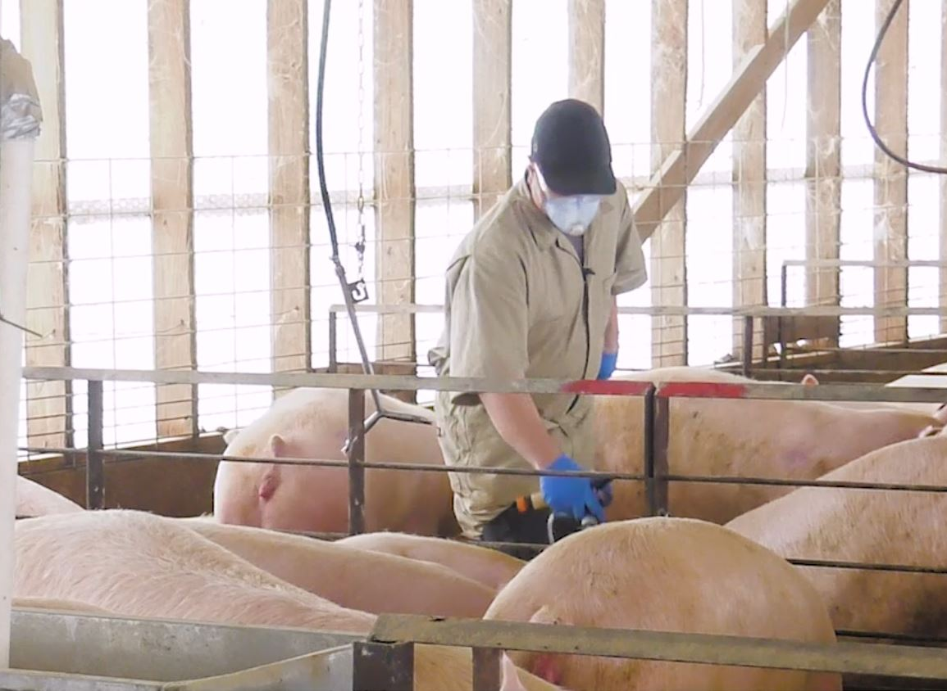
Vaccinating & Treating
In group sow housing environments, administer injections with or without restraint.
Step 7
Usually it is best to approach the sow from behind and inject quickly into the muscle of the neck without restraining her.
Keep your knees slightly bent while working in pens.
Sometimes it may be preferable to isolate a sow in a treatment pen and then administer the injection.

Slide 9
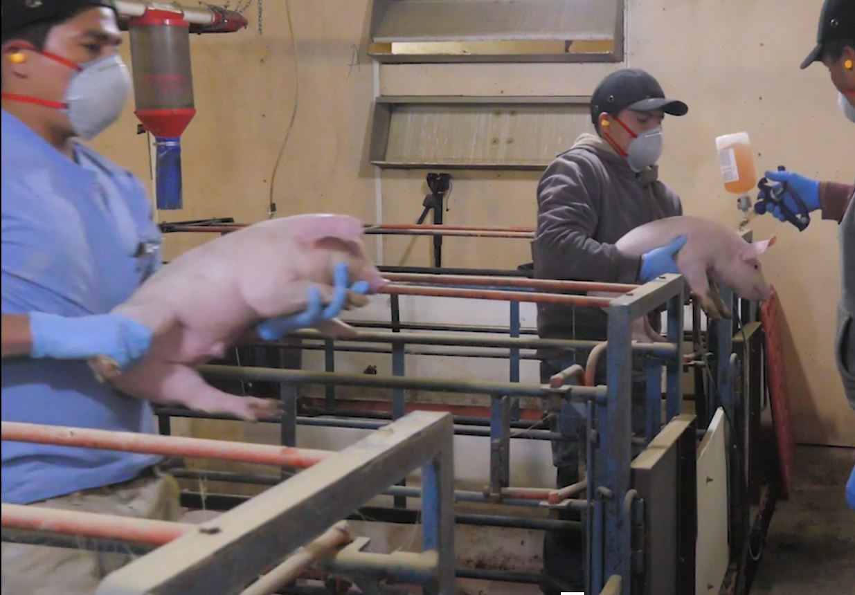
Vaccinating & Treating
In farrowing barns, pick up the pigs to administer injections.
Step 8
If you step in the stall, use caution so you don’t slip in feces or placenta.
Pay attention to the sow, she may be protective of her pigs and might try to bite your hand or arm.
Squat down to lift the pigs, don’t bend at the waist and lift with your back.
If you are working from outside of the stall, don’t lean over the side and reach too far, this can also strain your back.

Slide 10
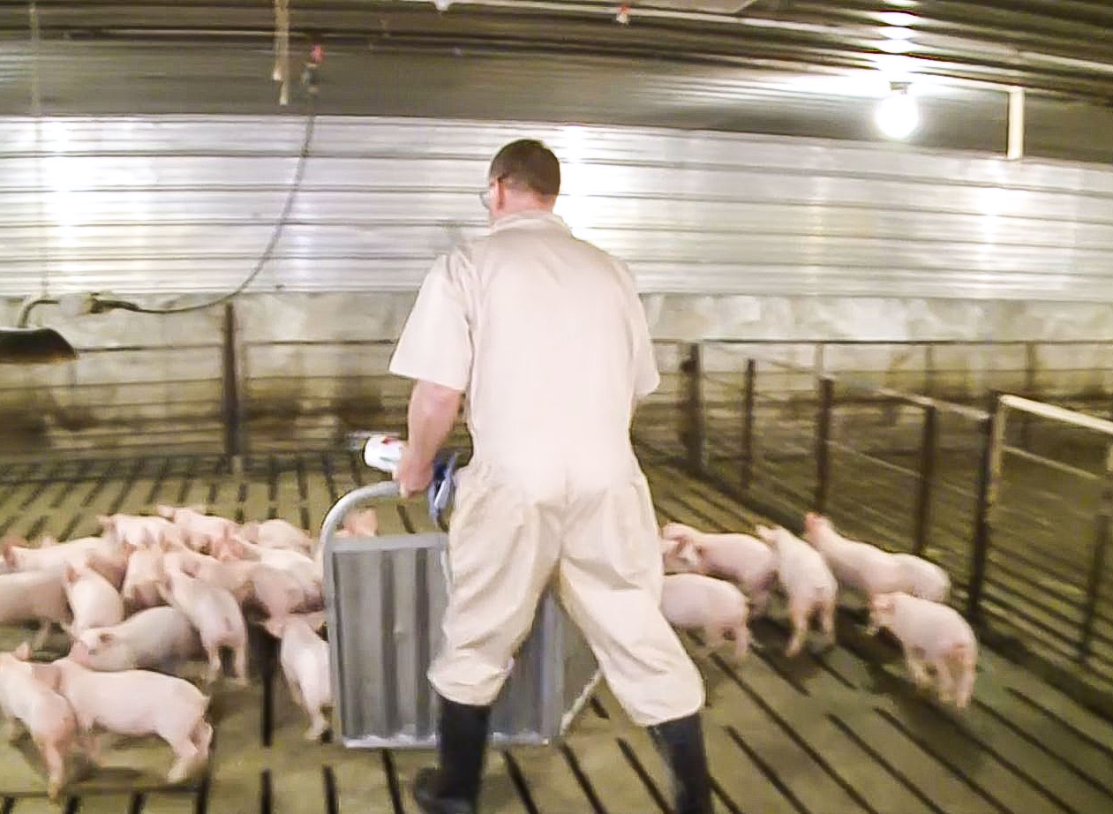
Vaccinating & Treating
Step 9
In nurseries or wean-to-market barns, use sort boards to crowd pigs.
Be mindful of pig movement.
If you or the pig you are injecting is bumped into, an accidental needle stick might occur.
Keep your knees slightly bent as you move through the pen.

Slide 11
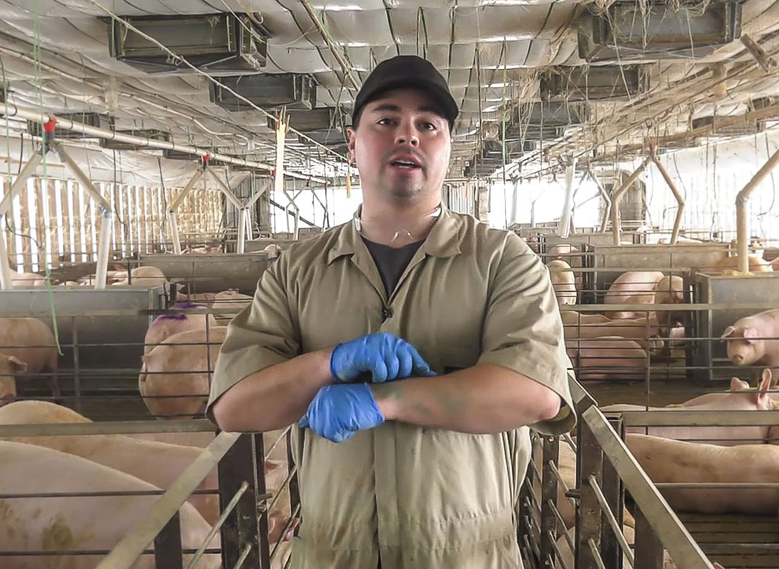
Vaccinating & Treating
Step 10
When a needle breaks in a pig or a person, follow your farm’s protocol.
Refer to the National Pork Board’s Needle Know-how resources for further information.

Slide 12
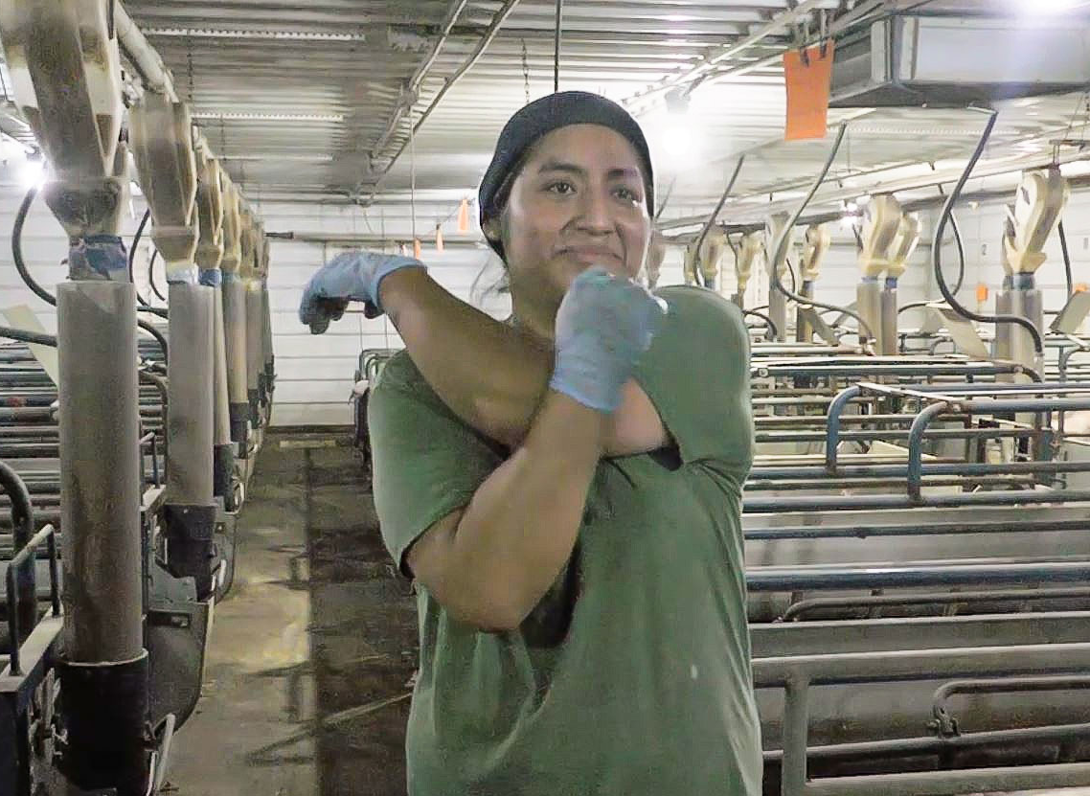
Vaccinating & Treating
Step 11
Prevent repetitive motion injury.
Start your shift with hand and wrist stretches to prepare your muscles for the tasks at hand.
Job rotation and regular short breaks will allow muscles time to recover from overuse.
Try to alternate hands and maintain a neutral wrist position.
Improper lifting, bending or stooping frequently strains the muscles in the back.
  Always lift with your knees and not your back.
  Avoid twisting at the waist and hold the animal or other load close to the body.
  Always allow plenty of time for your body to recover from physically demanding tasks.

